Slide 1
Databases– Part 2
Lesson 5 & 6
http://www.yahmad.co.uk/

Slide 2
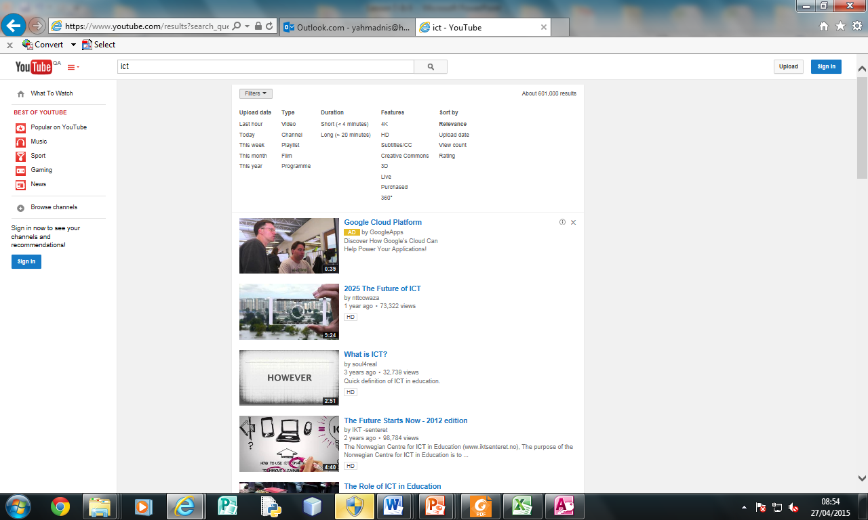
Starter 1 – Finding Information
You use a query if you want to search for specific data in a database using specific search criteria.
Discuss the different search criteria used in YouTube when searching for a clip?
Why would you use the different search criteria?
http://www.yahmad.co.uk/

Slide 3
Starter 2 – Discuss the different types of Search Criteria
Wild Card – Sometimes a field may contain more than one word. To find something specific you need to write a wildcard search. Like “* *” Like “* *” or “* *”
Between | Between 01/01/2010 And 02/02/2012 Between 5 And 15
Or | Adventure Or Horror
Not | Not “Horror”
<90 | Less than <90 <01/01/2014
>90 | More than >90 >31/12/2014
>=90 | More than and equal to >=90 >=01/01/2014
37*____ | Fields starts with 37
____*37 | Fields Ends with 37
http://www.yahmad.co.uk/

Slide 4
Lesson Overview
Objectives
To understand how queries can be used to search for specific data
To understand the different types of search criteria required when searching for information.
To understand the need to present information in a report format.
To understand how calculations can be created in queries & Reports.
Outcomes |  | Time
Task 1 | Complete the Simple Queries and Report
Task 2 | Complete the Queries and Report Calculated Fields Formulas in the Report
http://www.yahmad.co.uk/

Slide 5
Task 1 – Simple Query and Report
Create a Report for the following scenarios. Remember before you create the report you must create the Query.
Report 1: (Title: Amazon Sales) Show the following Fields only: Book Name, Author Name, Shop Name, Sold & Price Show only the records which include: ama222 (Amazon) Sort: Price: Descending Fits on a single page wide with a page orientation of Portrait (Ensure all labels are shown in full)
Report 2: (Title: Virgin) Show the following Fields only: Book Name, Shop Name, Headquarters Author, Nationality Show only the records which include: vin343 & Fantasy Sort: Book Name: Ascending Fits on a single page wide with a page orientation of Landscape (Ensure all labels are shown in full)
Report 3: (Title: Powell's Books) Show the following Fields only: Author Name, Book Name, Genre, Sold, Price & Online Show only the records which include: pow554 and Not Crime Sort: Book Name: Descending Fits on a single page wide with a page orientation of portrait (Ensure all labels are shown in full)
http://www.yahmad.co.uk/

Slide 6
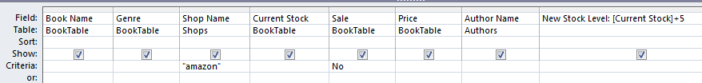
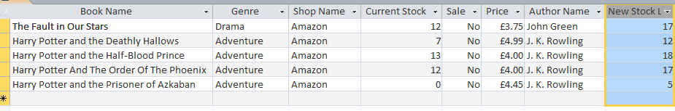
Calculated Run Time Fields
Calculated Run time is used when we have to calculate specific values using data from existing fields.
Enter New Calculated Run Time Field here
New Stock Level:[Current Stock]+5
Number of Books Added to Stock
Name of new field
Required Field in Square Brackets
+5
http://www.yahmad.co.uk/

Slide 7
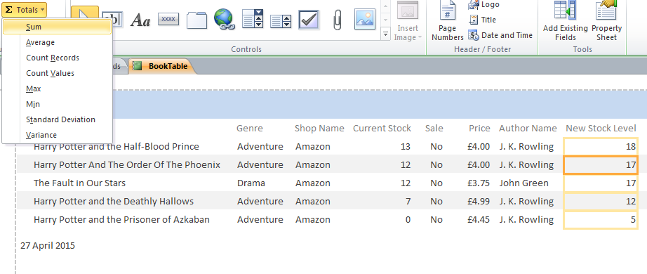
Formulas in Report
We can use a number of formula in the report to calculate values from fields including: Sum, Average, Count, Max, Min etc.
Function Tool
Selected Fields
http://www.yahmad.co.uk/

Slide 8
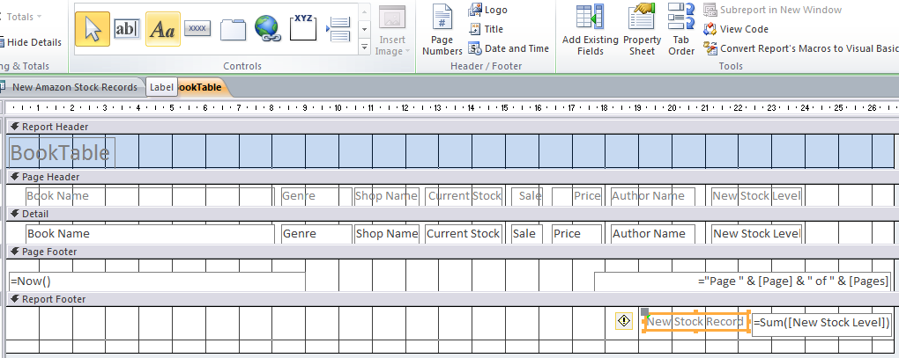
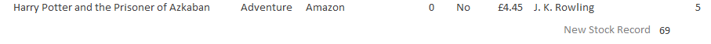
Formulas in Report (Design View)
Use the label tool too add a label next to the formula.
Label & Formula
Label & Formula in Report View
http://www.yahmad.co.uk/

Slide 9
Task 2 – Advanced Query and Report
Please Refer to the Video Tutorials Mobile Phone Insurance Make a query showing the following Fields: Book Name, Genre, Shop Name, Current Stock, Sale, Price & Author Show only the records which are not on sale and the shop name is Amazon. Sort: Current Stock: Descending Insert a new field called New Stock Level which is calculated at run-time – You need to add 5 to the current stock level.
Produce a Report: Has a report title: New Amazon Stock Records Fits on a single page wide ---- Has a page orientation of landscape Calculate the Total Sum of the New Stock Level
Extension: Complete extension queries and reports
http://www.yahmad.co.uk/

Slide 10
Plenary – Refer to the Lesson Objectives
Objectives
To understand how queries can be used to search for specific data
To understand the different types of search criteria required when searching for information.
To understand the need to present information in a report format.
To understand how calculations can be created in queries & Reports.
Plenary Task (Q&A)
Peer Assess each others work and suggest possible improvements. Discuss the levels pupils have achieved for this task.
http://www.yahmad.co.uk/

